Slide 1
A First Book of ANSI C Fourth Edition
Chapter 1
Introduction to Computer Programming

Slide 2
Objectives
History and Hardware
Programming Languages
Algorithms
The Software Development Process
Case Study: Design and Development
Common Programming Errors

Slide 3
History and Hardware
Babbage’s analytical engine (1822)
Atanasoff-Berry Computer (ABC, 1937)
Human operator manipulated external wiring
Electrical Numerical Integrator and Computer (ENIAC, 1946)
Vacuum tubes
Mark I (1944)
Mechanical relay switches
Electronic Delayed Storage Automatic Computer (EDSAC, 1949)
Incorporated a form of memory

Slide 4
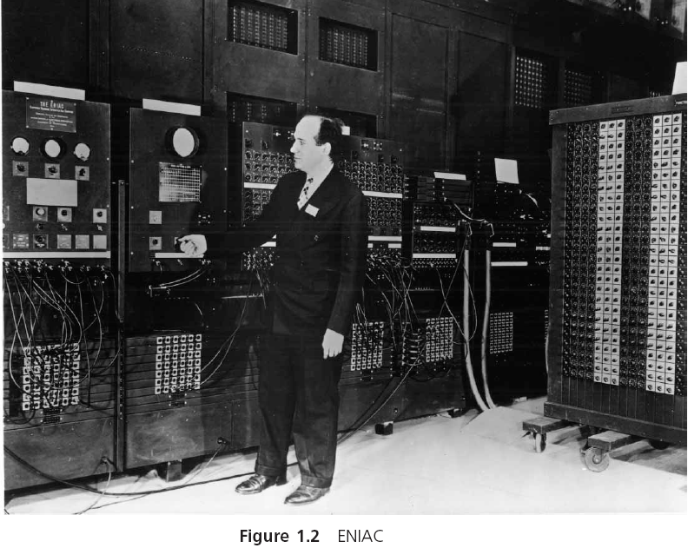
History and Hardware (continued)

Slide 5
Computer Hardware
Computers are constructed from physical components referred to as hardware
Hardware facilitates the storage and processing of data under the direction of a stored program
Computer hardware does not store data using the same symbols that humans do

Slide 6
Bits and Bytes
The smallest and most basic data item in a computer is a bit
Open or closed switch
0 or 1
The grouping of 8 bits to form a larger unit is referred to as a byte
Can represent any one of 256 distinct patterns
The collections of patterns consisting of 0s and 1s used to represent letters, single digits, and other single characters are called character codes

Slide 7
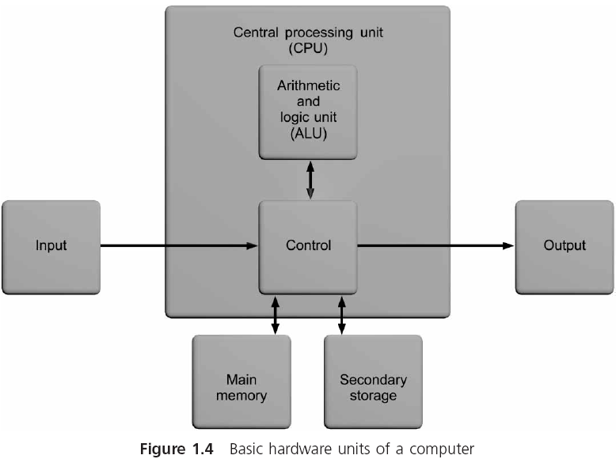
Components

Slide 8
Main Memory Unit
Stores data and instructions as sequence of bytes
A program must reside in main memory if it is to operate on the computer
Combines 1 or more bytes into a single unit, referred to as a word
Constructed as random access memory, or RAM
Every section of memory can be accessed randomly as quickly as any other section
Volatile: data is lost when power is turned off
Size is usually specified in bytes (MB or GB)
Notes:
Word: The computer's internal storage unit. Word "size" refers to the amount of data a processor's internal data registers can hold and process at one time. Business computers generally have word sizes of 32 or 64 bits.

Slide 9
Central Processing Unit (CPU)
Control unit: directs and monitors the overall operation of the computer
Keeps track of where the next instruction resides
Issues the signals needed to both read data from and write data to other units in the system
Executes all instructions
Arithmetic and Logic Unit (ALU): performs all of the computations, such as addition, subtraction, comparisons, and so on, that a computer provides
CPUs are constructed as a single microchip, which is referred to as a microprocessor

Slide 10
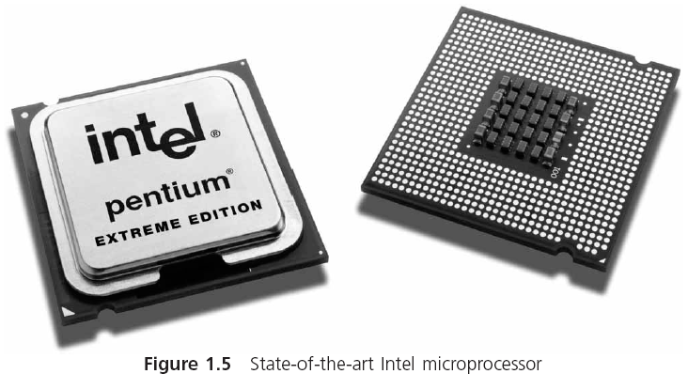
Microprocessor
Notes:
Dual Core
Hyper-Threading

Slide 11
Input/Output Unit
The input/output (I/O) unit provides access to the computer, allowing it to input and output data
It is the interface to which peripheral devices, such as keyboards, console screens, and printers, are attached

Slide 12
Secondary Storage
Used as permanent storage for programs and data
Magnetic tape, magnetic disks, and CD-ROMs
Direct access storage device (DASD): allows a computer to read or write any one file or program independent of its position on the storage medium
Magnetic hard disk consists of rigid platters that spin together on a common spindle
Initially, the most common magnetic disk storage device was the removable floppy disk

Slide 13
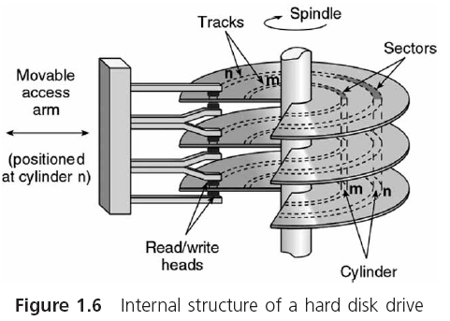
Magnetic Hard Disk

Slide 14
Programming Languages
Computer program: data and instructions used to operate a computer and produce a specific result
A program or set of programs is called software
Programming: writing instructions in a language that the computer can respond to and that other programmers can understand
Programming language: set of instructions that can be used to construct a program

Slide 15
Machine Language
Executable program: program that can operate a computer
Executable programs are written with binary numbers, which is a computer’s internal language (machine language)
An example of a simple machine language program containing two instructions is:
11000000000000000001000000000010
11110000000000000010000000000011
Opcode is short for operation code; tells the computer the operation to be performed

Slide 16
Assembly Language
Assembly language: uses the substitution of word-like symbols for the opcodes, and decimal numbers and labels for memory addresses
LOAD first
ADD second
MUL factor
STORE answer

Slide 17
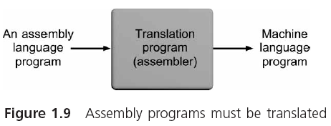
Assembly Language (continued)

Slide 18
Low- and High-Level Languages
Machine and assembly languages are low-level languages because they both use instructions that are directly tied to one type of computer
Programs written in a computer language are referred to as source programs and source code
When each statement in a high-level source program is translated individually and executed immediately upon translation, the programming language is called an interpreted language
Interpreter: program that translates each statement in a high-level source program and executes it immediately upon translation

Slide 19
Low- and High-Level Languages (continued)
Compiled language: the statements in a high-level source program are translated as a complete unit before any individual statement is executed
Compiler: translates a high-level source program as a complete unit before any statement is executed
The output produced by the compiler is called an object program (machine language version of the source code)
Linker: combines additional machine language code with the object program to create a final executable program

Slide 20
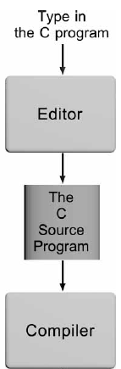
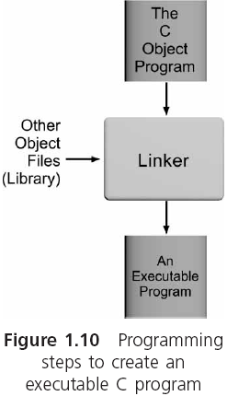
Low- and High-Level Languages (continued)

Slide 21
Procedural and Object-Oriented Languages
Procedural language: instructions are used to create self-contained units, called procedures
Procedure: accepts data as input and transforms it in some manner to produce a specific result as output
Also called function or method
Procedures conforming to structure guidelines are known as structured procedures

Slide 22
Procedural and Object-Oriented Languages (continued)
Structured language: high-level procedural language (e.g., C) that enforces structured procedures
Object-oriented languages: languages with object orientation such as C++, Java, Visual Basic, and C#

Slide 23
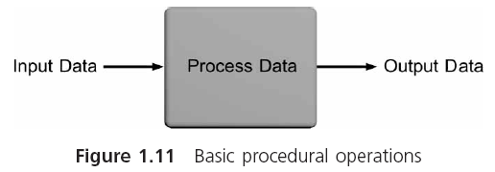
Procedural and Object-Oriented Languages (continued)

Slide 24
Application and System Software
Application software: programs written to perform particular tasks required by users
System software: collection of programs that must be readily available to any computer system to enable the computer to operate
The bootstrap loader is internally contained in ROM and is a permanent, automatically executed component of the computer’s system software

Slide 25
Application and System Software (continued)
Operating system: set of system programs used to operate and control a computer
Multiuser system: handles multiple users concurrently
Operating systems that permit each user to run multiple programs are referred to as both multiprogrammed and multitasking systems

Slide 26
The Development of C
Developed in the 1970s at AT&T Bell Laboratories by K. Thompson, D. Ritchie, and B. Kernighan
High-level structured language
Can also access the internal hardware of a computer
C permits a programmer to “see into” a computer’s memory and directly alter data stored in it
Standard maintained by the American National Standards Institute (ANSI)
In the 1980s, Bjarne Stroustrup (working at AT&T) developed C++
C with object-oriented capabilities

Slide 27
Algorithms
Algorithm: specific steps required to produce a desired result
Set n equal to 100
Set a equal to 1
Set b equal to 100
Calculate sum = n(a+ b)/2
Display the sum
When English phrases are used to describe an algorithm, the description is called pseudocode
Input the three numbers into the computer
Calculate the average by adding the numbers and dividing the sum by three
Display the average

Slide 28
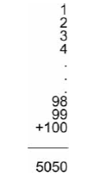
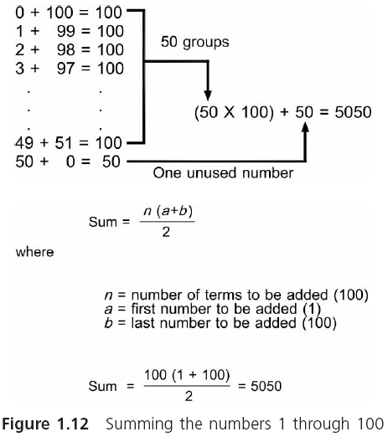
Algorithms (continued)

Slide 29
Algorithms (continued)
When mathematical equations are used to describe an algorithm, the description is called a formula
Flowchart: provides a pictorial representation of an algorithm using specifically defined shapes

Slide 30
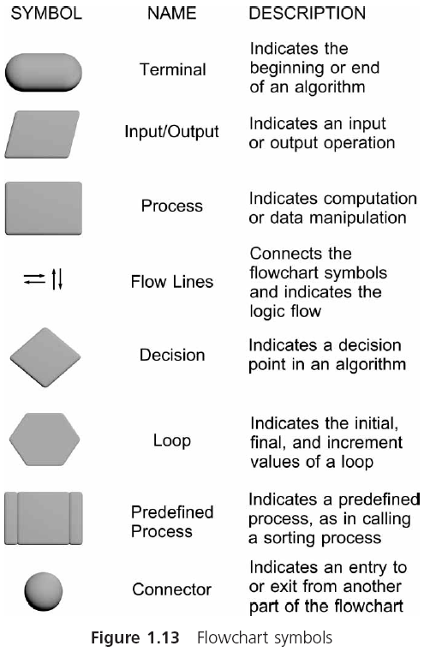
Algorithms (continued)

Slide 31
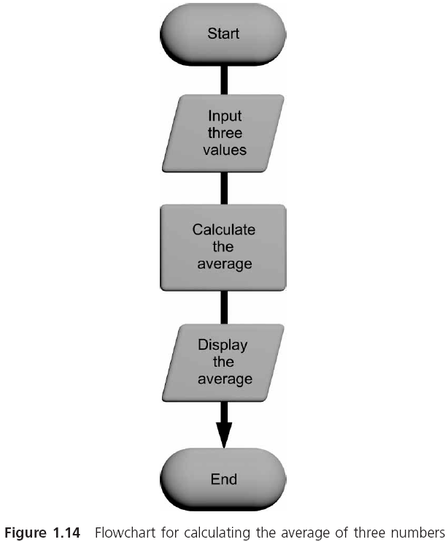
Algorithms (continued)

Slide 32
Algorithms (continued)
Converting an algorithm into a computer program, using a language such as C, is called coding the algorithm
The program instructions resulting from coding an algorithm are called program code, or simply code

Slide 33
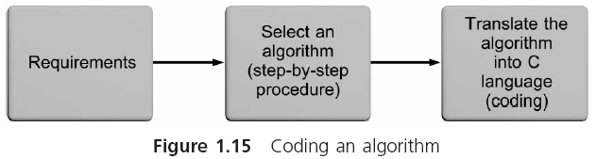
Algorithms (continued)

Slide 34
The Software Development Process
Each field of study has a name for the systematic method used to design solutions to problems
In science: called the scientific method
In engineering: called the systems approach
The technique used by professional software developers for understanding the problem that is being solved and for creating an effective and appropriate software solution is called the software development process

Slide 35
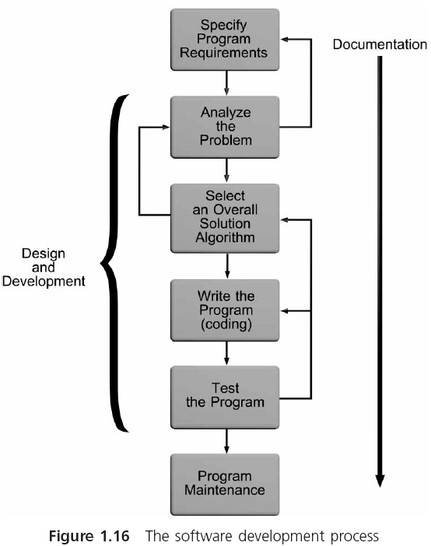
The Software Development Process (continued)

Slide 36
Phase I: Specify the Program’s Requirements
Begins with a problem statement or a specific request for a program, which is called a program requirement
Suppose you receive an e-mail from your supervisor that says: We need a program to provide information about circles
This is not a clearly defined requirement
To clarify and define the problem statement, your first step would be to contact your supervisor to define exactly what information is to be produced (its outputs) and what data is to be provided (the inputs)

Slide 37
Phase II: Design and Development
Step 1: Analyze the problem. You must understand:
The outputs that must be produced
The input data required to create the desired outputs
The formulas relating the inputs to the outputs
Step 2: Select an overall solution algorithm

Slide 38
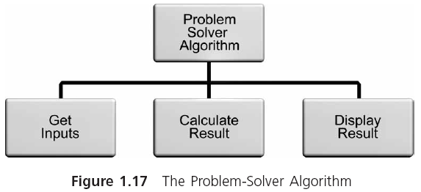
Phase II: Design and Development (continued)

Slide 39
Phase II: Design and Development (continued)
For larger programs you will have to refine the initial algorithm and organize it into smaller algorithms, with specifications for how these smaller algorithms will interface with each other
First-level structure diagram for an algorithm is the first attempt at a structure for a solution algorithm
Top-down algorithm development starts at the topmost level and proceeds to develop more and more detailed algorithms as it proceeds to the final set of algorithms

Slide 40
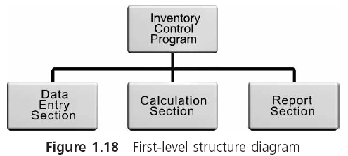
Phase II: Design and Development (continued)

Slide 41
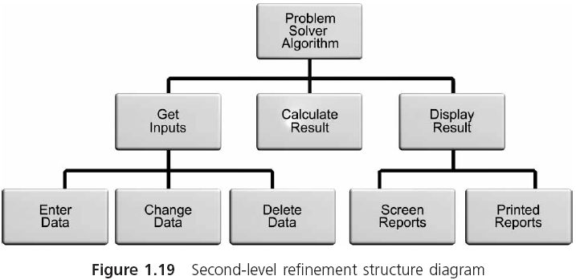
Phase II: Design and Development (continued)

Slide 42
Phase II: Design and Development (continued)
Step 3: Write the program (or code the algorithm)
Sequence structure defines the order in which instructions are executed by the program
Selection structure provides the capability to make a choice between different instructions, depending on the result of some condition
Repetition structure, also called looping or iteration, provides the ability for the same operation to be repeated based on the value of a condition
Invocation structure involves invoking specific sections of code as they are needed

Slide 43
Phase II: Design and Development (continued)
Step 4: Test and correct the program
A program error is called a bug
Testing attempts to ensure that a program works correctly and produces meaningful results
If you find an error, initiate debugging: locating, correcting, and verifying the correction
Develop a set of test data that determines whether the program gives correct answers
The tests should examine every possible situation under which a program will be used

Slide 44
Phase III: Documentation
Six documents for every problem solution:
The requirements statement
A description of the algorithms that were coded
Comments within the code itself
A description of modification and changes made over time
Sample test runs, which include the inputs used for each run and the output obtained from the run
A user’s manual, which is a detailed explanation of how to use the program

Slide 45
Phase IV: Maintenance
How easily a program can be maintained (corrected, modified, or enhanced) is related to the ease with which the program can be read and understood

Slide 46
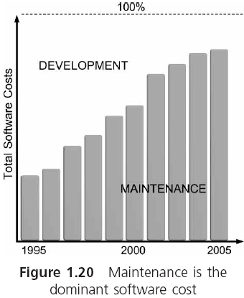
Phase IV: Maintenance (continued)

Slide 47
Backup
Making and keeping backup copies of your work when writing a program is critical
Not part of the formal software development process
Backup is unimportant if you don’t mind starting all over again
Many organizations keep at least one backup on site where it can be easily retrieved, and another backup copy either in a fireproof safe or at a remote location

Slide 48
Case Study: Design and Development
The circumference, C, of a circle is given by the formula C = 2πr, where π is the constant 3.1416, and r is the radius of the circle. Using this information, write a C program to calculate the circumference of a circle that has a 2-inch radius.
Step 1: Analyze the problem
Determine the desired outputs
Determine the input items
List the formulas relating the inputs to the outputs
Perform a hand calculation

Slide 49
Case Study: Design and Development (continued)
Step 2: Select an overall solution algorithm
Set the radius value to 2
Calculate the circumference, C, using the formula C = 2 π r
Display the calculated value for C
Step 3: Write the program (see next slide)
Step 4: Test and correct the program
The circumference of the circle is 12.566400
Because only one calculation is performed by the program, testing Program 1.1 really means verifying that the single output is correct

Slide 50
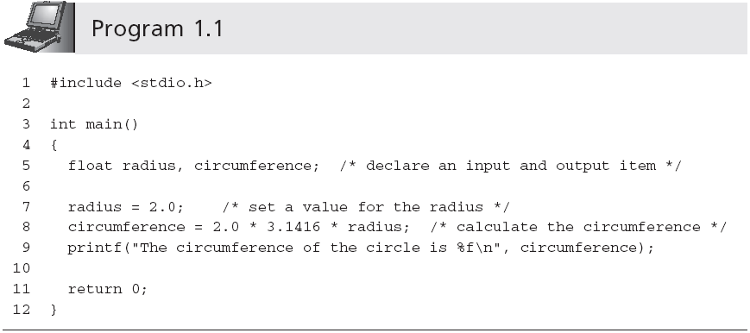
Case Study: Design and Development (continued)

Slide 51
Common Programming Errors
Rushing to write and execute a program without spending sufficient time learning about the problem or designing an appropriate algorithm
Forgetting to back up a program
Not understanding that computers respond only to explicitly defined algorithms

Slide 52
Summary
The first attempt at creating a self-operating computational machine was by Charles Babbage in 1822
The physical components used in constructing a computer are called hardware
The programs used to operate a computer are referred to as software
Programming languages come in a variety of forms and types
Compiler and interpreter languages are referred to as high-level languages

Slide 53
Summary (continued)
Algorithm: step-by-step sequence of instructions that must terminate and describes how to perform an operation to produce a desired output
The software development procedure consists of the following four phases:
Specification of the program’s requirements
Design and development
Documentation
Maintenance

Slide 54
Summary (continued)
Steps of the design and development phase are:
Analyze the problem
Select an overall solution algorithm
Write the program
Test and correct the program
Writing a program consists of translating the solution algorithm into a computer language
Fundamental programming control structures
Sequence, selection, iteration and invocation
You always need at least one backup of a program

